Slide 1
Looking after your families well-being

Slide 2
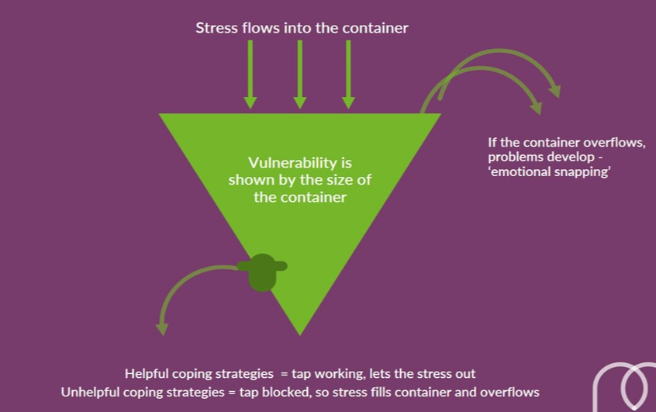
Looking after yourself

Slide 3
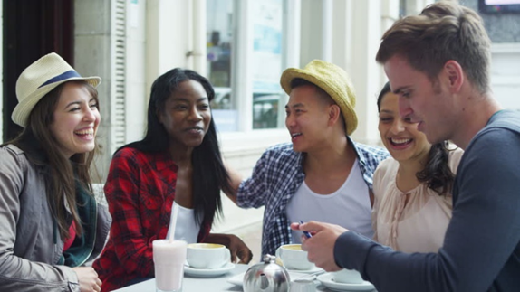
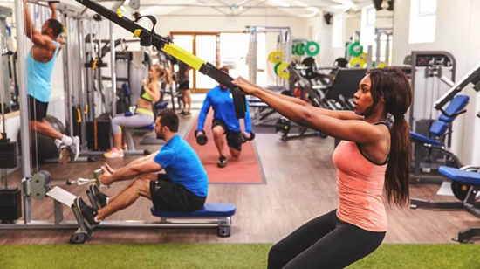
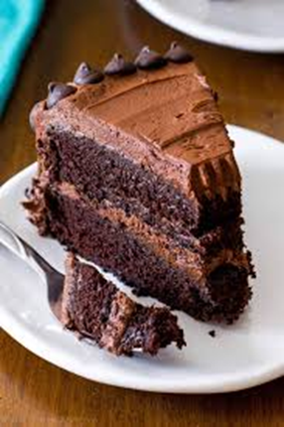
What do you do to de-stress?

Slide 4
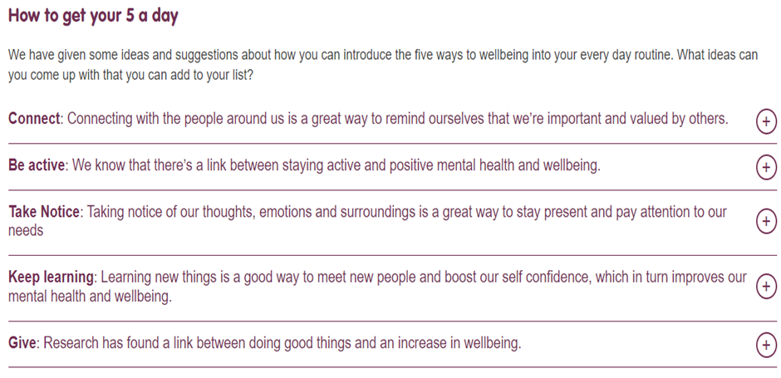
Protecting your well-being ideas
Use a well-being app
Listen to a mindfulness podcast
Details are in the handout

Slide 5
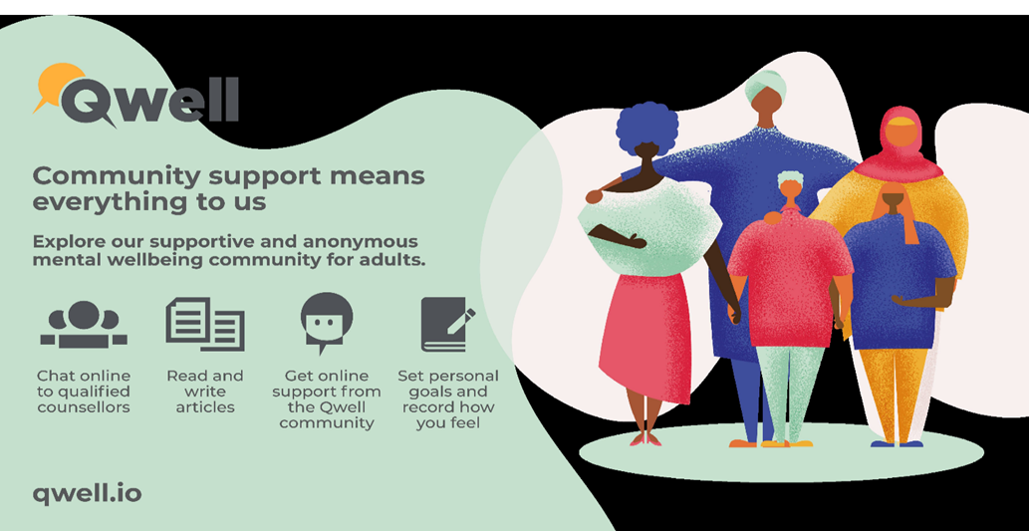
What help is available?
Talk to the Inclusion team
Chat to your GP

Slide 6
Your children’s well-being

Slide 7
Happiness boxes
Details are in your handout

Slide 8
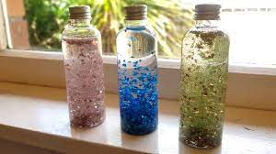
Mindfulness
https://www.youtube.com/watch?v=xLoK5rOl8Qk&t=95s

Slide 9
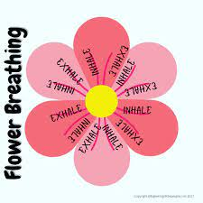
Breathing techniques

Slide 10
Older siblings

Slide 11
Any concerns?
Please speak to school either through your class teacher or the Inclusion team who can help to get your child support

